Slide 1


FIT9136 PASS WEEK 9
Introduction to Python Library and Packages
16th Sep 2024
CL_33 Innovation Walk, Room C107 / Online

Slide 2

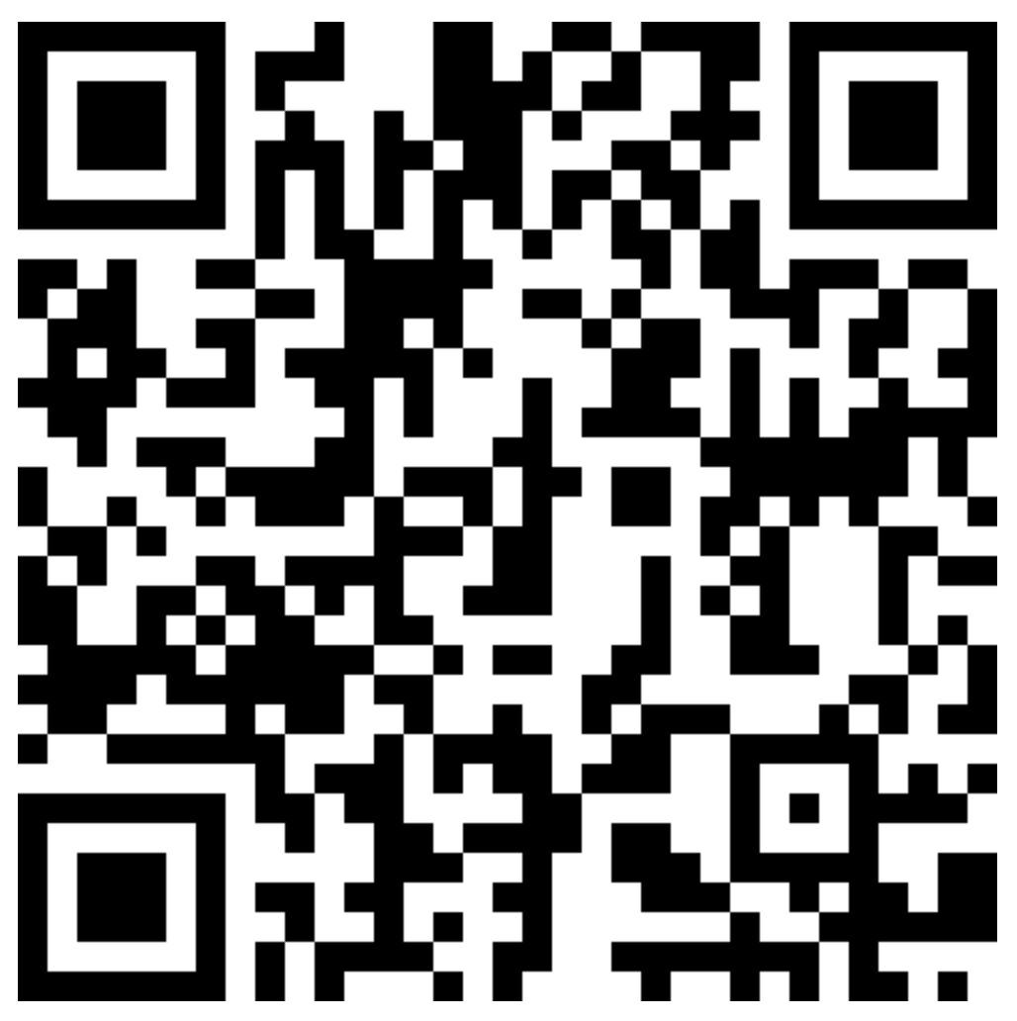

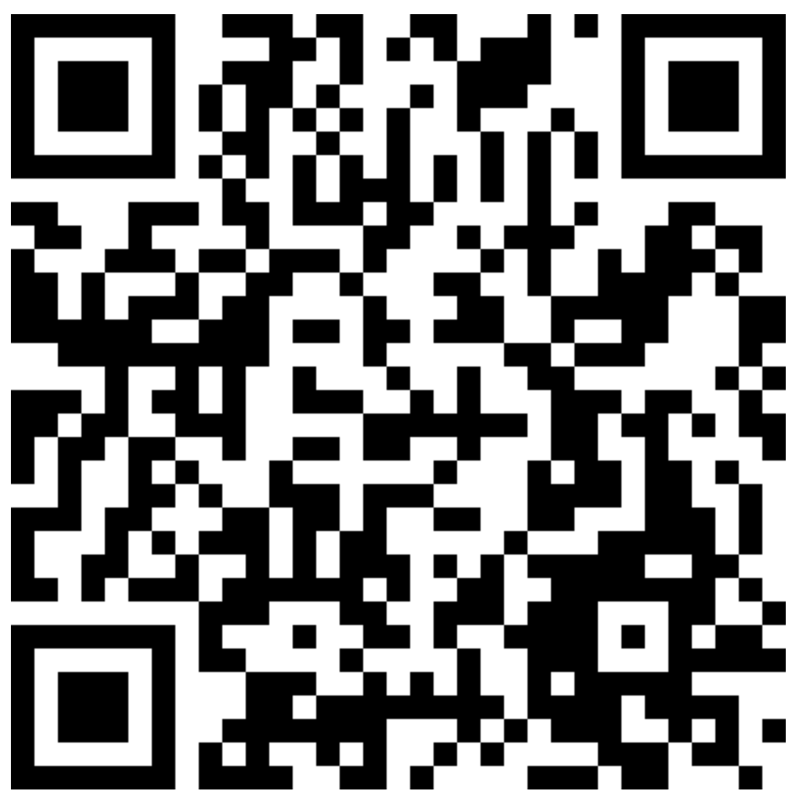

Attendance & Resources
Any questions? Email me: harry.wang1@monash.edu
Also find the drive to receive the weekly slides: https://tinyurl.com/FIT9136-PASS
Want to have GitHub Repo to access them? GitHub: https://github.com/chiefhaowang/PASS-Weekly
SSH: git@github.com:chiefhaowang/PASS-Weekly.git
HTTPS: https://github.com/chiefhaowang/PASS-Weekly.git
Monday 2-3pm
Tuesday 9-10am
Tuesday 4-5pm

Slide 3
Agenda
01
Packages - 20 mins
Concept recap
02
Problem Solving Section - 30 mins
03
Closure speaking - 10 mins
Conclusion + Q&A + Attendance recording

Slide 4
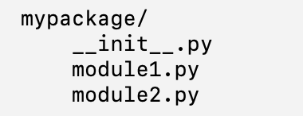
Module? Package?
A module is simply a single Python file (a .py file) that contains Python code, such as functions, classes, variables.
A package is a collection of modules organized in a directory structure. The presence of a special file called __init__.py in a directory makes it a package. The __init__.py file can be empty or contain initialization code for the package.

Slide 5
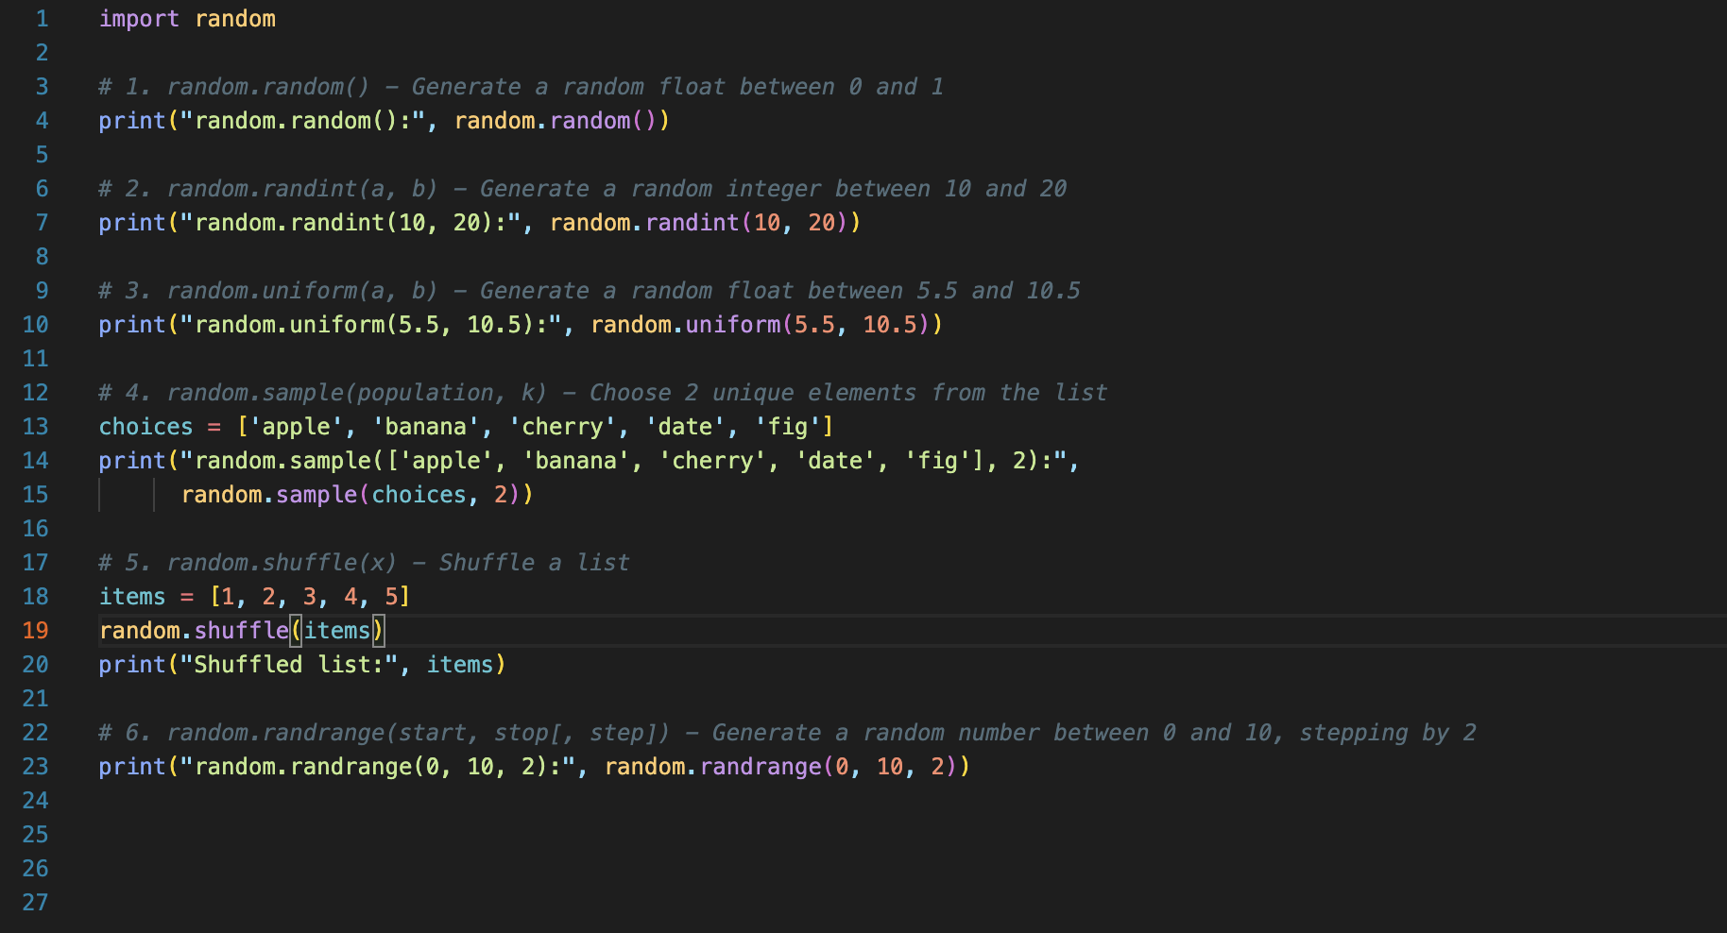
Common modules - random
Base code: https://tinyurl.com/FIT9136-PASS/code/material_recap/random_examples.py

Slide 6
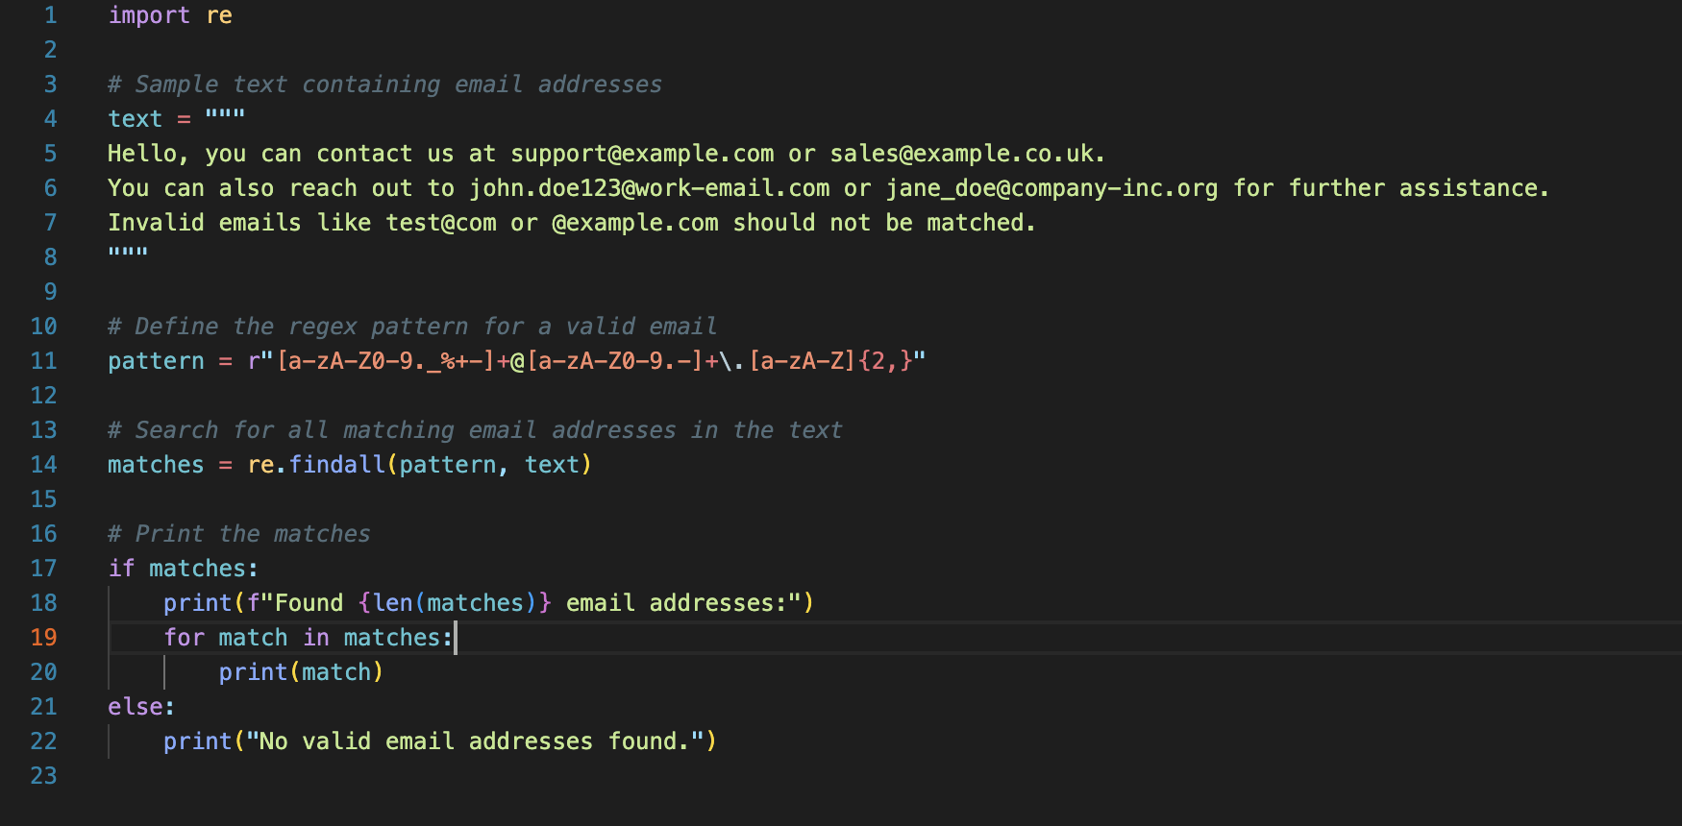
Common modules - re
Regex is commonly used to search for patterns within strings.
Base code: https://tinyurl.com/FIT9136-PASS/code/material_recap/re_examples.py

Slide 7
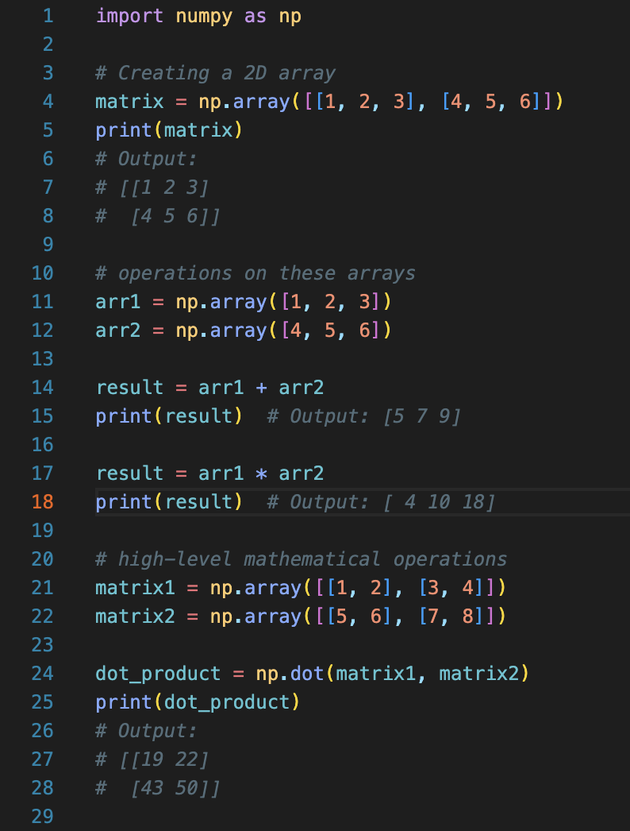
Common packages - NumPy
NumPy is a popular Python library used for working with arrays, matrices, and performing a wide variety of mathematical operations. It stands for Numerical Python and is the fundamental package for scientific computing in Python.
NumPy provides support for:
Multi-dimensional arrays (n-dimensional arrays or ndarray).
A large collection of mathematical functions to operate on these arrays efficiently.
Linear algebra, random number generation, and other high-level mathematical operations.
Base code: https://tinyurl.com/FIT9136-PASS/code/material_recap/numpy_examples.py

Slide 8
Common packages - Pandas
Pandas is an open-source Python library used for data manipulation and analysis. It is particularly well-suited for working with structured data, like tabular data (like spreadsheets or SQL tables), time series, and matrices.
DataFrame: A two-dimensional labeled data structure, similar to a table in a relational database or an Excel spreadsheet.
Series: A one-dimensional labeled array capable of holding any data type.
Data Manipulation: Functions for filtering, merging, grouping, aggregating, and transforming data.
Handling Missing Data: Tools to handle missing values with ease.
Read/Write: Functions to read from and write to different file formats like CSV, Excel, JSON, SQL, and more.
Base code: https://tinyurl.com/FIT9136-PASS/code/material_recap/pandas_examples.py

Slide 9
Common packages - Matplotlib
Matplotlib is a widely used Python data visualization library. It provides functions to create a variety of static, animated, and interactive visualizations in Python. It is especially powerful for creating plots like line charts, bar charts, scatter plots, histograms, and much more.
Data Visualization: It helps you visualize data in different formats (line graphs, bar charts, scatter plots, histograms, etc.).
Customization: It provides extensive options for customizing plots (titles, labels, legends, annotations, colors, etc.).
Integration: It integrates well with other libraries such as NumPy and pandas, making it suitable for data science and machine learning workflows.

Slide 10
Common packages - SciPy
SciPy (pronounced as sigh-pie) is a library built to extend NumPy into more extensive scientific functionality.

Slide 11
Problem Solving Section
Please find the base code here: https://tinyurl.com/FIT9136-PASS/code/problem_solving/interview_simulator_question.py
Please find the code challenge description here:https://tinyurl.com/FIT9136-PASS/code/problem_solving/Interview Response Simulator Code Challenge Description.pdf
You can also find the solution here: https://tinyurl.com/FIT9136-PASS/code/problem_solving/interview_simulator_solution.py

Slide 12

Let’s see what we got today
What is Module and Package?
How to use functions inside these modules or packages?
How to find and use these packages?
Have you got your Python syntax practiced?

Slide 13
Attendance & Resources
Any questions? Email me: harry.wang1@monash.edu
Also find the drive to receive the weekly slides: https://tinyurl.com/FIT9136-PASS
Want to have GitHub Repo to access them? GitHub: https://github.com/chiefhaowang/PASS-Weekly
SSH: git@github.com:chiefhaowang/PASS-Weekly.git
HTTPS: https://github.com/chiefhaowang/PASS-Weekly.git
Monday 2-3pm
Tuesday 9-10am
Tuesday 4-5pm

Slide 14
Thank You
16th Sep 2024
CL_33 Innovation Walk, Room C107 / Online

Slide 15
Questions & Answers
16th Sep 2024
CL_33 Innovation Walk, Room C107 / Online

